Slide 1
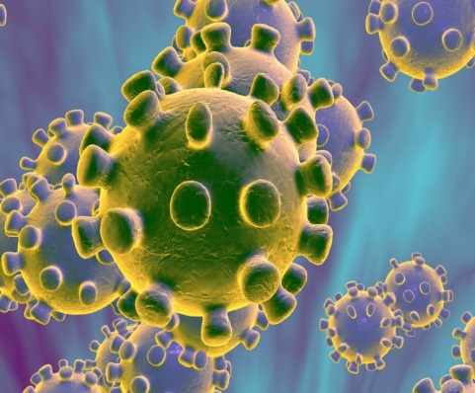


Management of the critically ill adult patient with confirmed or suspected COVID-19
May 7th 2020v3
Notes:
In late December 2019, the WHO was informed of a cluster of cases of pneumonia of unknown cause in Wuhan City, China. On 12 January 2020 it was announced by the WHO that a novel Coronavirus had been identified as the causative agent. The outbreak was declared a Public Health Emergency of International Concern by WHO on 30th January 2020 and a Pandemic on 11th March

Slide 2
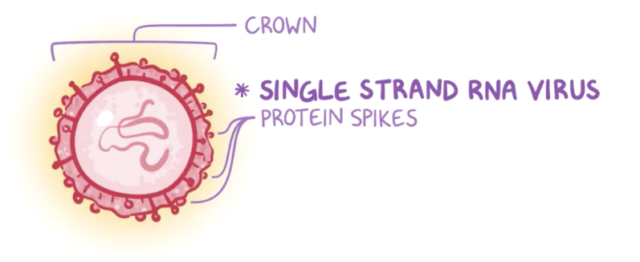
Virus: SARS-CoV-2
Disease: COVID-19
Notes:
The virus is a single stranded enveloped RNA betacoronavirus called SARS-CoV-2 (SARS-CoV-1 being the virus that causes SARS)
The disease caused by this virus is called COVID-19

Slide 3
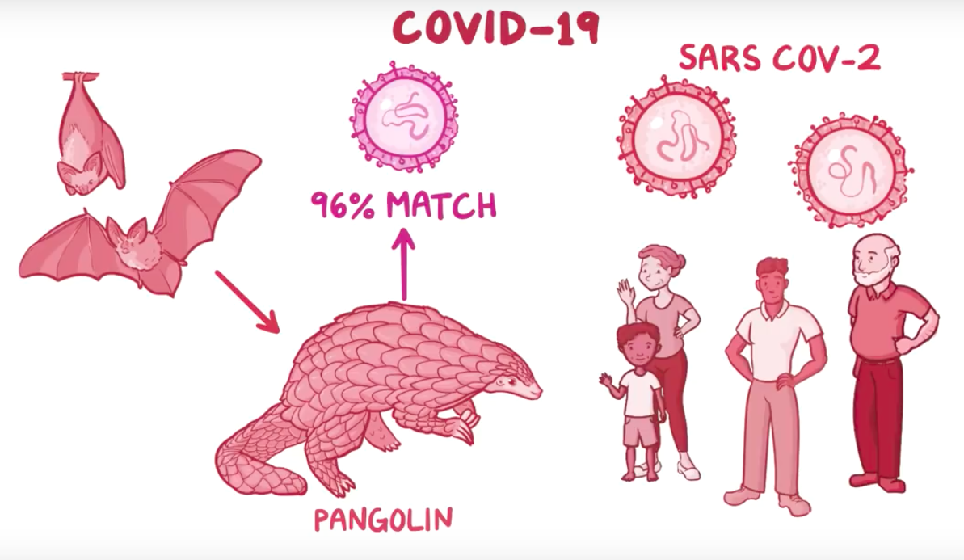
Notes:
We think COVID-19 originated in bats and then infected humans via Pangolins as the viral RNA of this virus has a 96% match for a bat coronavirus. Pangolins are thought to have healing properties in their scales and are therefore valuable animals and were traded in the Huanan seafood market in Wuhan where the virus likely originated.

Slide 4
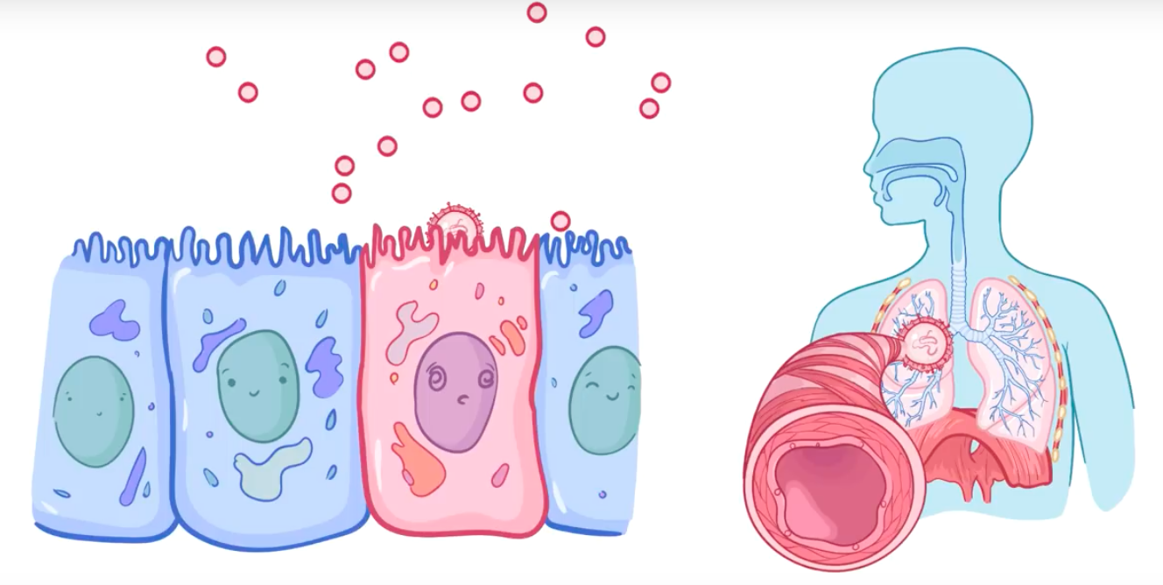
The virus is thought to spread mainly by droplet and direct contact and less frequently by aerosol spread.
The viral protein spikes attach onto ACE 2 receptors in alveolar cells and the infected patients quickly develop a high viral load.
Notes:
The virus is thought to spread mainly by droplet and direct contact and less frequently by aerosol spread. The viral protein spikes attach onto ACE 2 receptors in alveolar cells and the infected patients quickly develop a high viral load. There are also ACE II receptors on in the GI mucosa and some patients will present with GI symptoms.

Slide 5
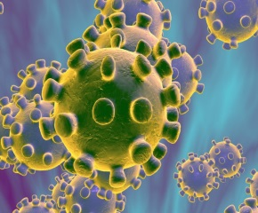
COVID-19
EPIDEMIOLOGY

Slide 6

GLOBAL DASHBOARD of COVID-19 (CSSE)
https://gisanddata.maps.arcgis.com/apps/opsdashboard/index.html#/bda7594740fd40299423467b48e9ecf6?utm_source=vancouver%20is%20awesome&utm_campaign=vancouver%20is%20awesome&utm_medium=referral
Thursday 7th May
Notes:
COVID-19 has spread rapidly around the globe with large numbers of infections initially in China, South Korea Italy and Iran. In Europe Spain overtook Italy as the worst effected country in Europe with 220,325 cases as of 7th May but the UK has reported the highest number of deaths at 30,150.

Slide 7
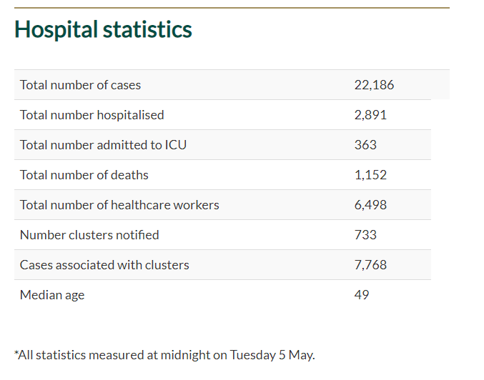
Irish Hospital Statistics as of Midnight 5th May
13%
1.6%
5.2%
29.2%
https://www.gov.ie/en/press-release/fe4551-statement-from-the-national-public-emergency-team-7-may/#cases-as-at-tuesday-5-may-2020
Notes:
In Ireland 13% of confirmed cases have required hospitalisation and 1.6% were admitted to ICU

Slide 8

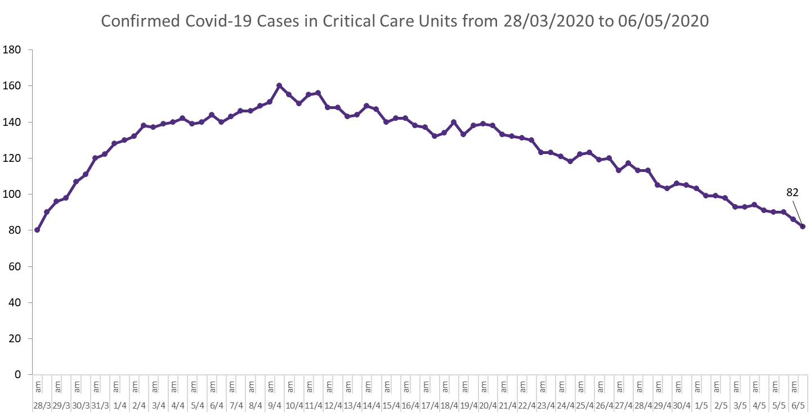
Notes:
The first wave of ICU admissions peaked on 10th April and numbers have been declining since. Further surges may occur as social distancing measures are relaxed. It’s a marathon, not a sprint. It is estimated that 150-200 ICU beds will need to be available on an ongoing basis to look after COVID19 patients for the next number of months. While overall ICU capacity was not overwhelmed some movement of patients for capacity reasons was necessary.

Slide 9
Clinical Characteristics

Slide 10

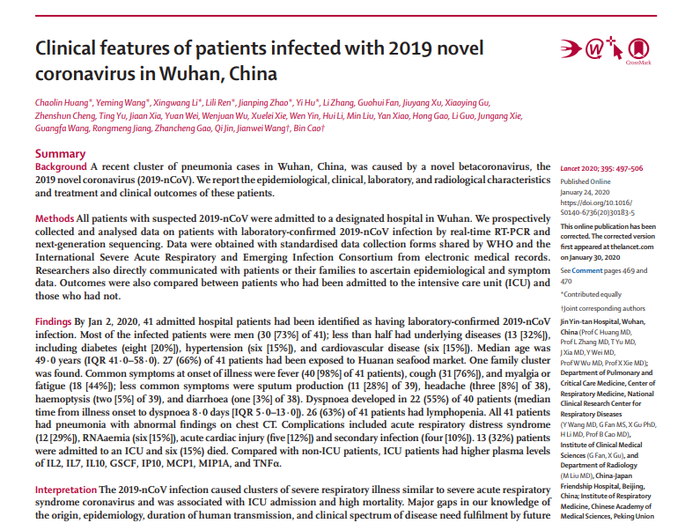
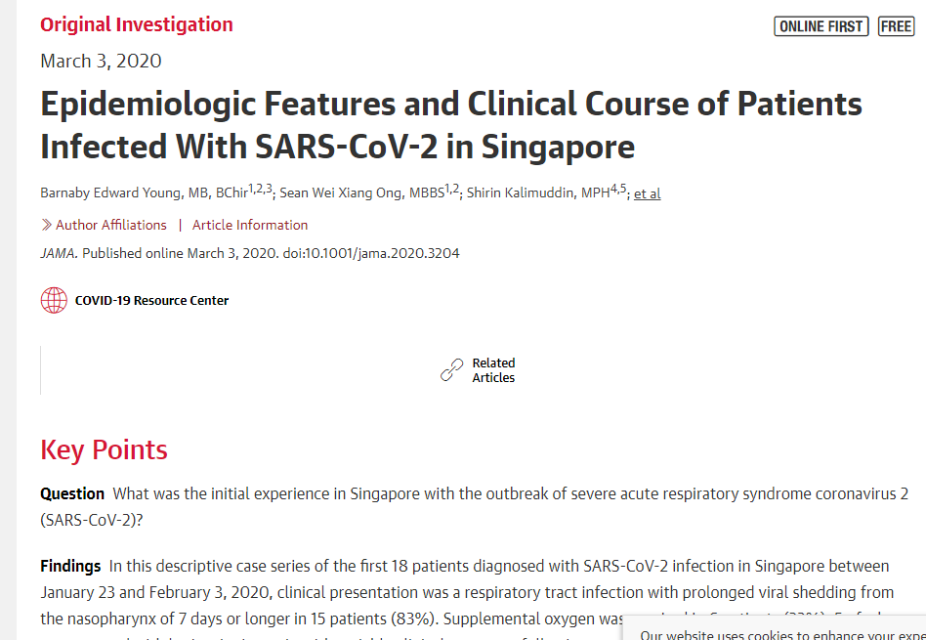
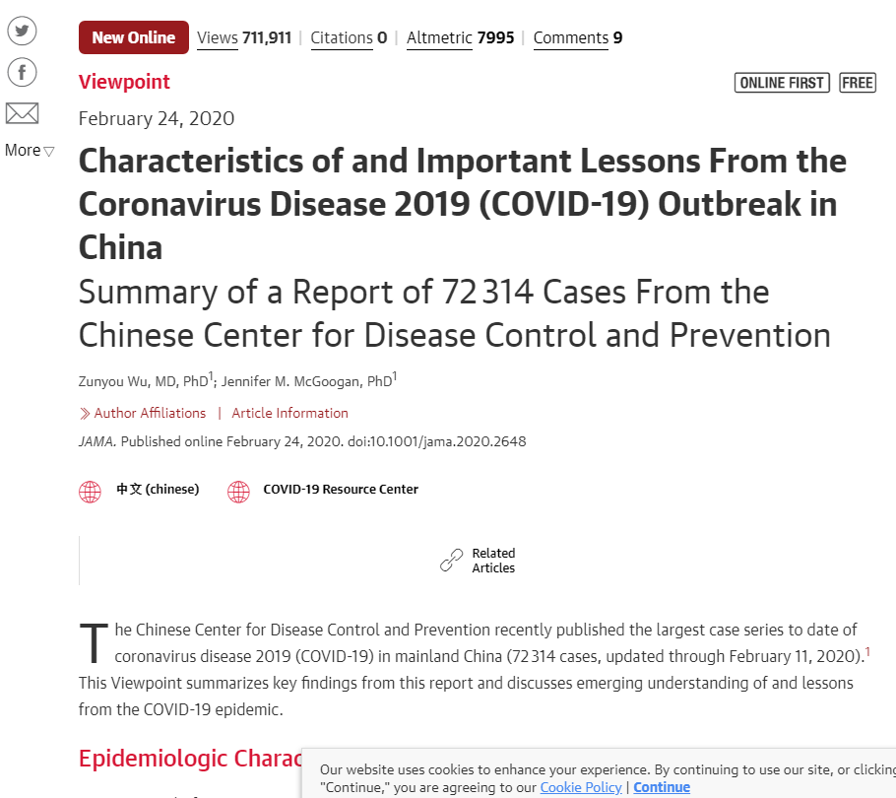
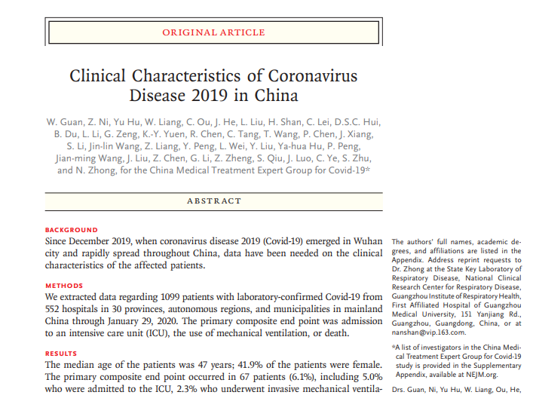
Notes:
A number of publications have described the clinical characteristics of COVID 19 in China and Singapore. The presenting complaints have been fairly consistent but the incidence will vary depending on the severity of disease.

Slide 11
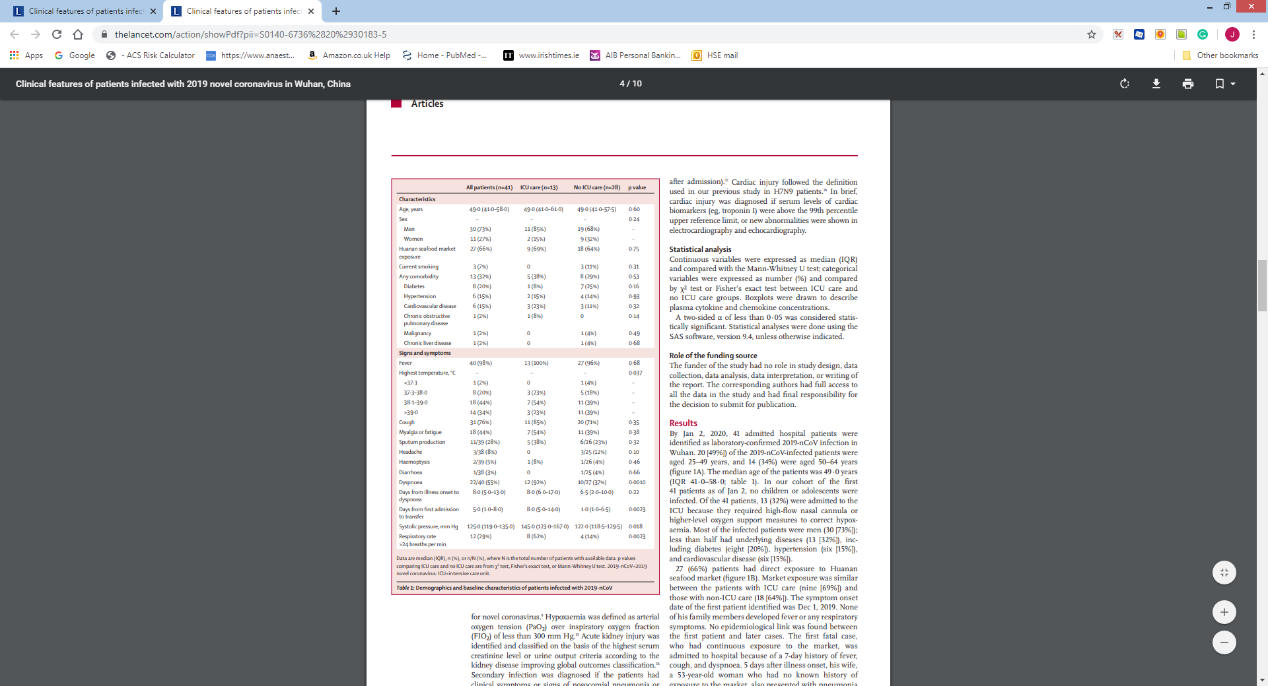

Notes:
In patients with severe disease requiring critical care, nearly all will have fever, 85% will have cough and 92% will be dyspnoic.

Slide 12

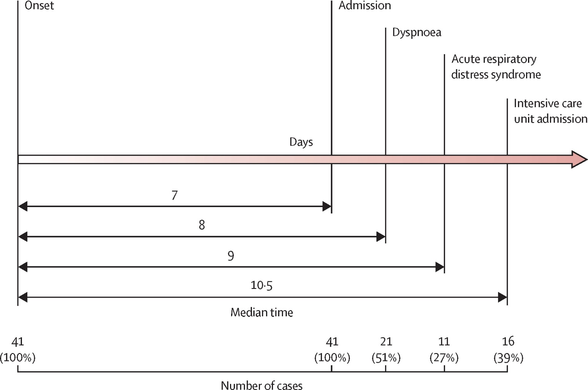
DISEASE PROGRESSION
The Lancet 2020 395, 497-506DOI: (10.1016/S0140-6736(20)30183-5 Copyright © 2020 Elsevier Ltd
The typical timeline of the disease is of a few days of malaise followed by dry cough, fever and dyspnoea. The average time from hospital admission to requirement for critical care is 24-48 hours.

Slide 13
Laboratory testing for COVID-19
3 Viral swabs available in a pre-prepared pack
  1 nasopharyngeal swab and
  2 throat swabs in viral transport medium
Lower respiratory tract sample (e.g. BAL) recommended in intubated patients who have had negative NP/Throat swab.
Microbiologist-on –call should be contacted if COVID-19 testing to take place.
A single negative test result, particularly if this is from an upper respiratory tract specimen, does not exclude COVID-19
Repeat sampling and lower respiratory specimen is strongly recommended in suspect patients with severe or progressive disease.
A positive alternate pathogen does not necessarily rule out COVID-19 as little is yet known about the role of co-infections.
Notes:
Confirmation of the disease requires detection of viral RNA. Nasopharyngeal and throat swabs are currently recommended. The swabs may be negative in patients who do not have symptoms. The virus can also be detected in blood and stool.
The rate of viral co-infection is low but bacterial co-infection may be common and standard CAP antibiotics are recommended. In intubated patients in the post viraemic phase, nasopharyngeal and throat swabs may be falsely negatives and a lower respiratory sample (e.g. BAL) may be required to make the diagnosis.

Slide 14
Clinical Course
Severe Acute Respiratory Infection (SARI)
Type I respiratory failure (often hypocapnic)
ARDS
Near normal compliance lungs
Severe shunt
Secondary Complications
  Septic Shock
  Acute Renal Failure
  Myocarditis
  Pulmonary Embolism
7-10 days IPPV required
Notes:
COVID 19 can present as a Severe Acute respiratory infection. The patients typically have type 1 respiratory infection and are often hypocarbic. 85% of ICU patients will meet criteria for ARDS and in fact most Italian data indicated that by the time of intubation most patients meet criteria for severe ARDS.
Despite severe hypoxia, lung compliance is often normal or near normal and care needs to be taken not to cause VILI while on IPPV.
Septic shock occurs in 23% of patients and AKI in 23%.
Myocarditis is common (17-29%) and can be a delayed phenomenon at a median of 15 days into the illness in one study. Fulminant myocarditis in not infrequently a cause of death in these patients. This may need to be considered when using experimental potentially cardiotoxic drugs to treat the primary disease or perhaps a reason to closely follow troponin levels in patinets on those drugs

Slide 15
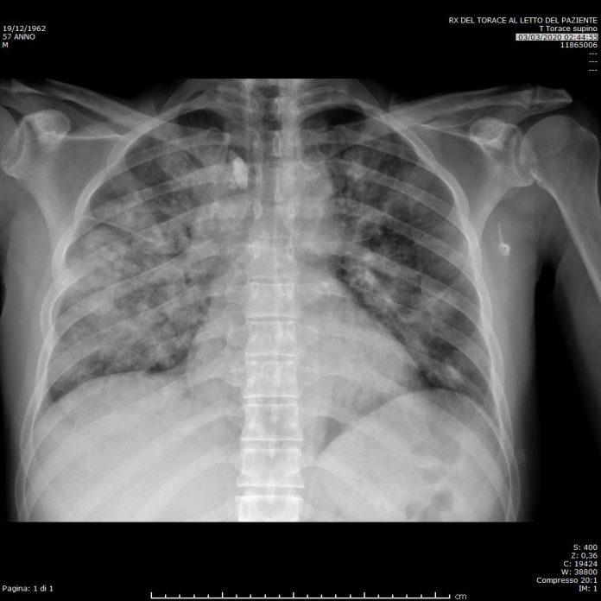
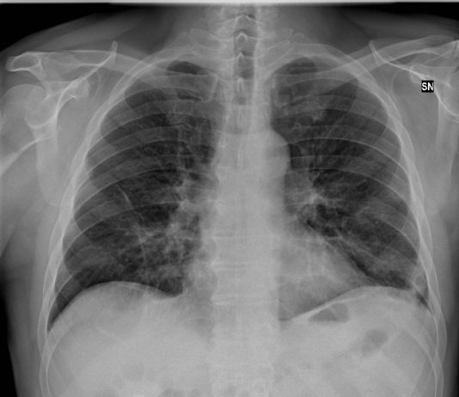
CXR usually shows bilateral infiltrates but is occasionally normal even in severe cases
Notes:
CXR usually shows bilateral infiltrates but is occasionally normal even in severe cases

Slide 16
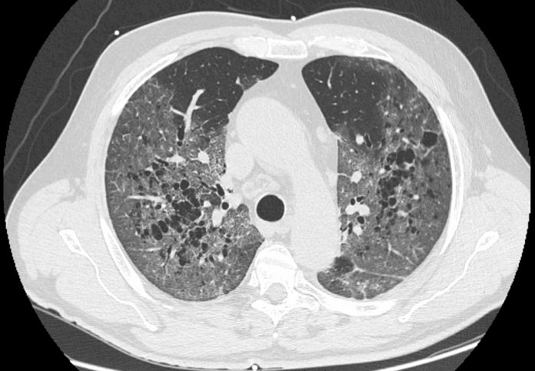
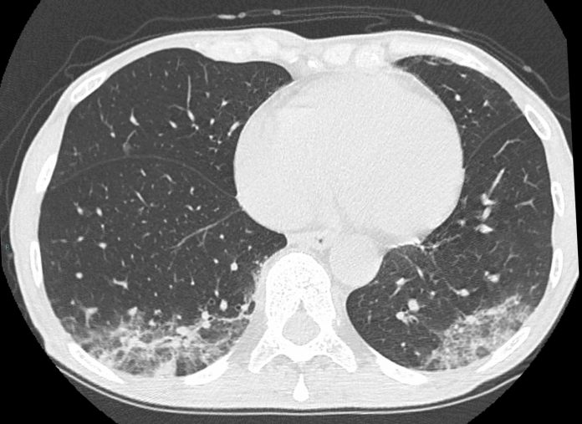
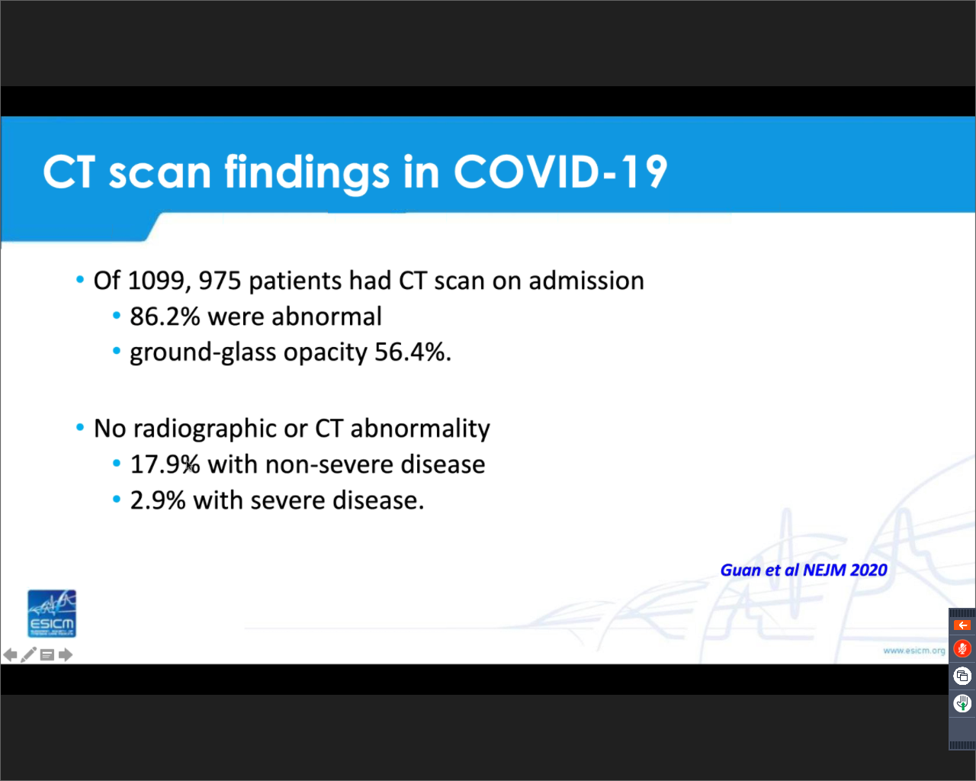
Notes:
CT Thorax usually shows bilateral alveolar infiltrates or ground glass opacification but is occasionally normal at presentation.
Septic shock is an unusual presentation.
Leucopenia and lymphopenia are common and lymphopenia is a marker of severity of disease and outcome.

Slide 17
Prevention of Spread
&
Protection of HealthCARe WORKERS

Slide 18
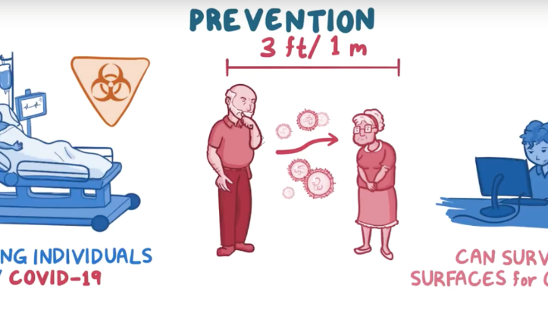
Transmission
Direct contact (hand to mucus membrane)
Droplet (contact within 1m of infected patient)
Aerosols: Smaller airborne particles which can travel around a room
Notes:
Prevention of spread is the first priority for healthcare workers in order to protect themselves and to prevent further nosocomial infection.
Many critical care procedures will generate aerosols

Slide 19


As of 5th May 2020, 6,498 healthcare workers in Ireland have been infected with COVID -19.
This equates to 29.2% of all cases reported in the Republic of Ireland. (22,186)
https://www.gov.ie/en/press-release/fe4551-statement-from-the-national-public-emergency-team-7-may/#cases-as-at-tuesday-5-may-2020

Slide 20




SOCIAL DISTANCING AT WORK
It is important that healthcare workers keep to a distance at work of 2m when having lunch, coffee breaks etc. Surgical masks should be worn by all healthcare workers for all encounters, of 15 minutes or more, with other healthcare workers in the workplace where a distance of 2m cannot be maintained.
2M
https://www.hpsc.ie/a-z/respiratory/coronavirus/novelcoronavirus/guidance/infectionpreventionandcontrolguidance/ppe/useofsurgicalmasksinhealthcaresetting/

Slide 21
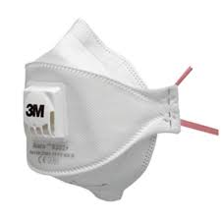
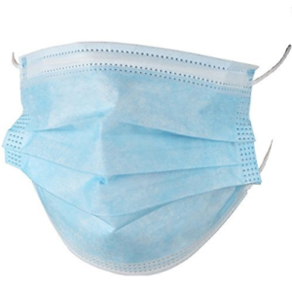
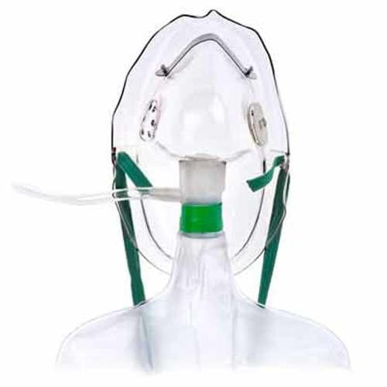
FFP3 or surgical mask (over NP)
Mask or Non-rebreather for Transfer
Notes:
To contain droplets and potential transmission from symptomatic patients, a surgical face mask must be provided to and worn by patients when not in isolation (nasal prong oxygen can be delivered underneath a surgical mask). For hypoxic patients not in a negative pressure room , a non-rebreather face mask is appropriate with an O2 flow of 10-15L The use of FFP2/3 face mask is to prevent inhalation of aerosols, intended for the use of healthcare workers.

Slide 22

Aerosol generating procedures
Procedures that produce aerosols of respiratory secretions carry an increased risk of transmission:
  NIV/CPAP/HFNC
  bronchoscopy
  induced sputum
  positive-pressure ventilation via a face mask
  intubation and extubation
  airway suctioning
  CPR
Notes:
Many critical care procedure will generate aerosols. Such aerosols can travel around the room the patient is in and potentially cause infection. If possible, all these procedures should be performed in a negative pressure room with a minimal number of HCW all of whom must be wearing full PPE.

Slide 23
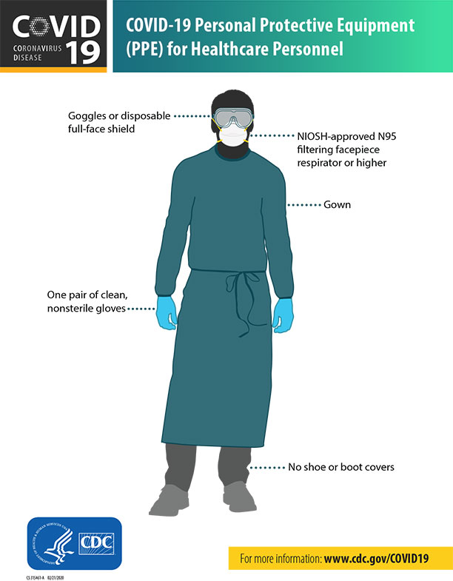
Personal Protective Equipment
FFP3 Filter Mask
Visor or Goggles (glasses not sufficient)
Long sleeved water resistant gown
Gloves
Hat
Notes:
Necessary PPE includes FFP3 Filter Mask, Visor or Goggles (glasses are not sufficient), a long sleeved water resistant gown and gloves which cover the wrist.

Slide 24
Technique for Donning and Doffing of PPE
Donning
Doffing
Perform Hand hygiene
Put on Gown and hat
Put on FFP3 mask
Fit Check Mask
Place mask over nose, mouth and chin
Fit flexible nose piece over nose bridge
Secure on head with elastic
Adjust to fit
Inhale- mask should collapse
Exhale- check for leakage around face
4. Put on Eye Protection – goggles or face shield
5. Put on gloves
In the patients’ room
Remove Gloves
Perform Hand hygiene
Remove Goggles –avoid touching the front
Remove Gown -avoid touching the front of the apron/gown
Perform Hand hygiene
In ante room or directly outside patients' room- Ensure door is closed
1. Remove Mask
Grasp and lift ties from behind your head and pull off respirator away from your face.
Avoid touching the front of the respirator and use ties to discard.
2. Perform Hand hygiene
https://www.youtube.com/watch?v=Gy4StHAHMU4
https://www.youtube.com/watch?v=pNirkWLjMX0
Notes:
The linked youtube clips demonstrate correct technique for donning and doffing of PPE. It is recommended to use the buddy system to ensure correct technique when dealing with COVID-19 patients. This is particularly the case if aerosol generating procedures may be necessary. HCW with facial hair including beards and moustaches require further respirator support with a power air-purifying respirator (PAPR) option.

Slide 25
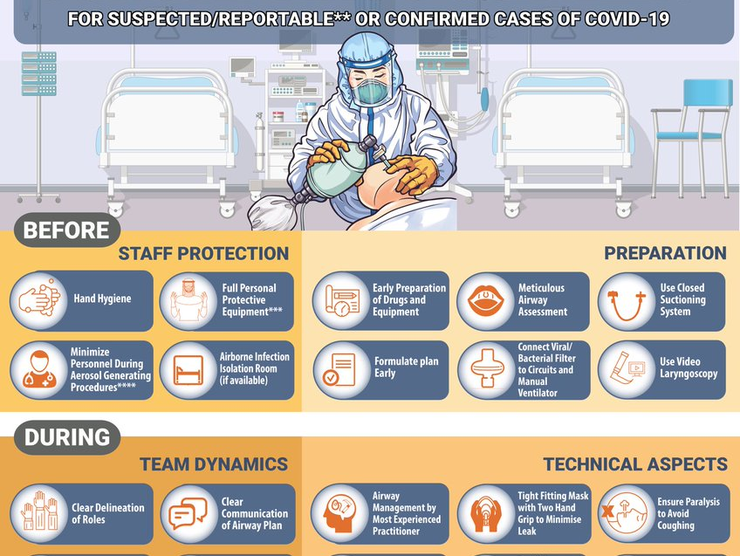
Notes:
Intubation of these patients needs to be semi-elective if at all possible and the general principles are:
Apply PPE (double gloving recommended)
Most experienced operator available should perform intubation
Standard monitoring, i.v. access, instruments, drugs, ventilator and suction checked.
Avoid awake fiberoptic intubation unless specifically indicated as atomized local anaesthetic will aerosolize the virus. Consider videolaryngoscope
Plan for rapid sequence induction (RSI) and ensure skilled assistant able to perform cricoid pressure. RSI may need to be modified, if patient has very high A-a gradient and is unable to tolerate 30 s of apnoea, or has a contraindication to succinylcholine. If manual ventilation is anticipated, small tidal volumes should be applied.
Five minutes of preoxygenation with oxygen 100% and RSI in order to avoid manual ventilation.
High efficiency filter between facemask and breathing circuit
Intubate and confirm correct position of tracheal tube.
Institute mechanical ventilation and stabilize patient.
All Airway equipment must be sealed in a plastic bag and removed for decontamination and disinfection.
Assistant should then wipe down surfaces with appropriate disinfectant (as directed by the hospital) after exiting the negative-pressure atmosphere.
After removing protective equipment, avoid touching hair or face before hand hygiene

Slide 26

Critical Care Equipment
Protect respiratory equipment with a high efficiency filter (eg BS EN 13328-1).
Use disposable respiratory equipment where possible
Decontaminate re-usable equipment in accordance with the manufacturer’s instructions
Use closed suctioning systems
Ventilator circuits should not be broken unless necessary
Place ventilators on standby when carrying out bagging
Notes:
To reduce aerosol generation in COVID patients to a minimum the following precautions should be observed:

Slide 27

Operating theatre
Decisions regarding the need for surgery during the period of infectivity should be made by senior clinicians.
Patient should be anaesthetised and recovered in the operating room
Staff should wear appropriate PPE
Disposable anaesthetic equipment should be used where possible
The anaesthetic machine should be protected by a filter with viral efficiency of 99.99%
Reusable anaesthetic equipment should be decontaminated as per manufacturer’s instructions
Operation room should be cleaned and disinfected after use
Operating room should not be used for 15 minutes after patient leaves (based on a conventional ventilation system with 20 air changes per hour)
Notes:
If a COVID-19 patient requires emergency surgery, care needs to be taken to avoid infection in the operating room and the ICSI guidelines document at the end of this presentation gives appropriate advice.

Slide 28
Treatment
Notes:
Many observational studies have suggested benefit to different drug treatments but the quality of the evidence is poor and sometimes conflicting. Two RCT’s of antiviral therapies have been published with Remdesivir showing the most promise. Well conducted RCT’s are underway for other drug therapies. Supportive treatment remains the mainstay of therapy.

Slide 29
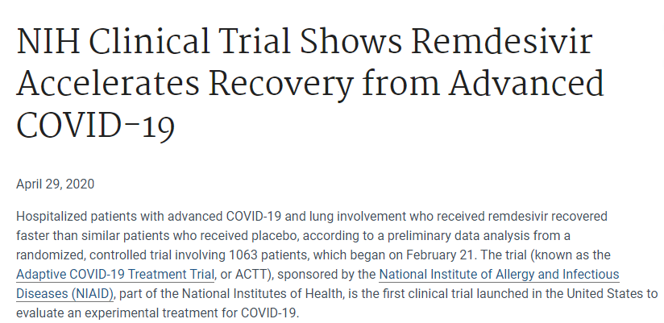
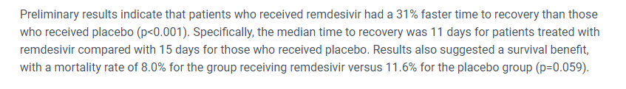
Notes:
A RCT of Remdesivir in 1100 patients showed a faster resolution of disease and a trend towards improved survival in the treatment arm.

Slide 30
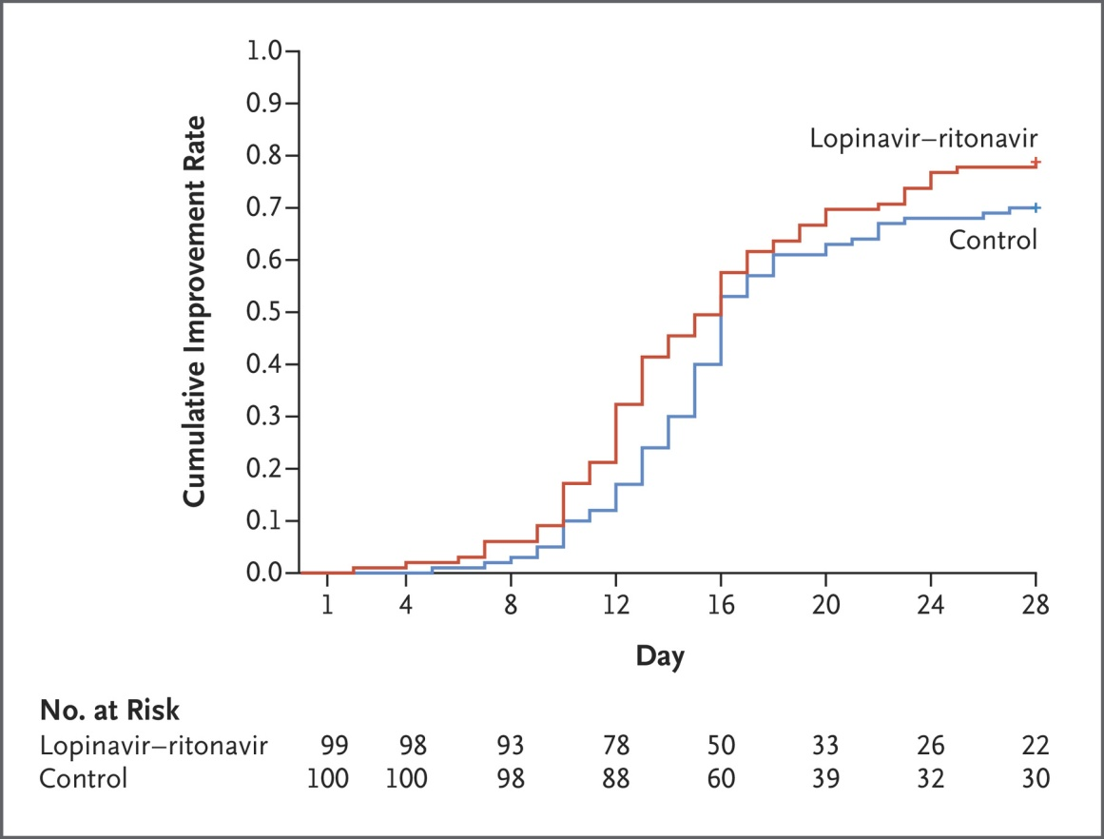
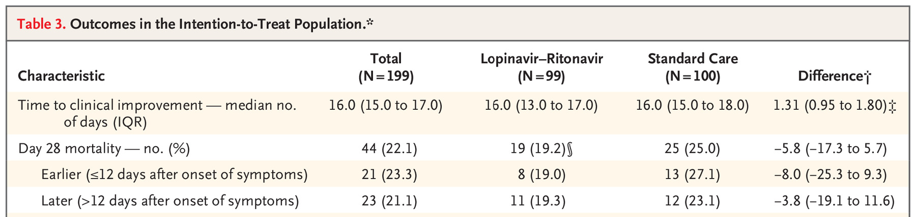
Notes:
A small Trial of Lopinavir–Ritonavir in Adults Hospitalized with Severe Covid-19 was negative but there was a non-significant trend towards improved 28 day mortality in the treatment group. Diarrhoea is a problematic side effect of Lopinavir-Ritonavir

Slide 31


Current Clinical Trials / Studies
The administration of any antivirals must be by direction of Infectious Disease / Consultant Microbiologist and ideally within a clinical trial
WHO SOLIDARITY TRIAL
REMAP CAP
SPRINT-SARI/ISARIC
APPROVE-CARE
RECOVERY
CORONACION

Slide 32
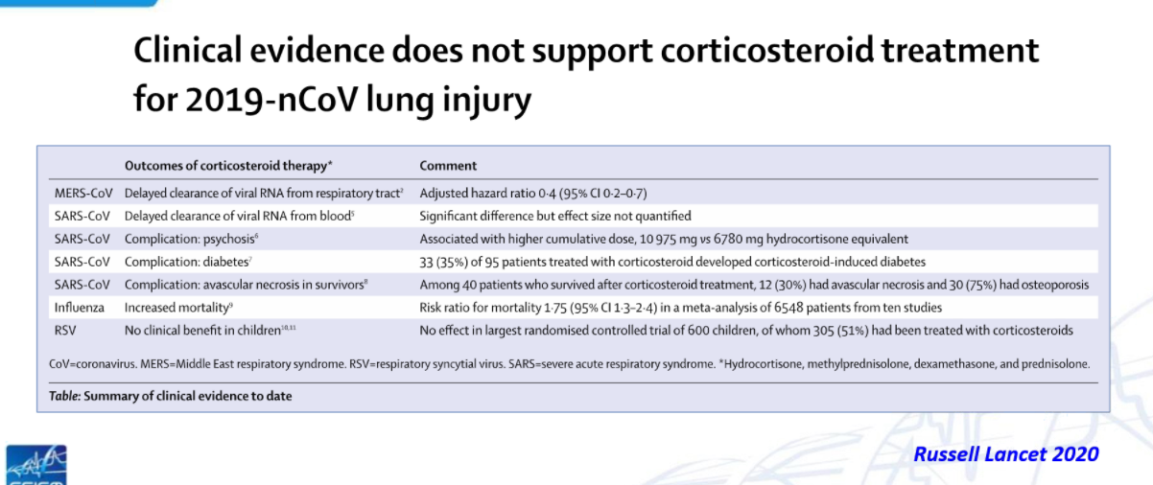
Notes:
Clinical evidence does not support the use of corticosteroids for COVID-19 outside of a clinical trial setting. They may be indicated for other reasons in COVID-19 patients such as bronchospasm or refractory shock.

Slide 33
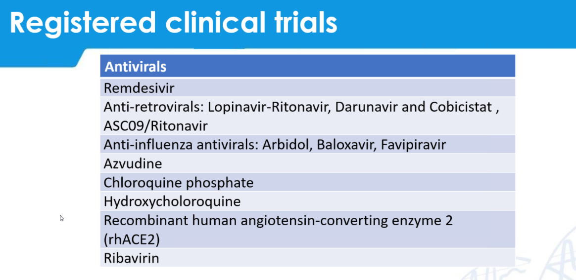
Notes:
There are a number of other investigational compounds which have been used to treat the disease.
Hydroxychloroquine and azithromycin have been widely used but data is of poor quality and conflicting and QTc prolongation can be a problem with these drugs.

Slide 34
Bacterial infections
Bacterial infections co-infection may occur (although uncommon)
Superinfection has been reported in up to 42% of patients
Risk factors for superinfection include:
  Age
  Severity of disease
  Glucocorticoids
  Prophylactic antibiotics
  Indwelling devices
  Diabetes
There should be a low threshold to obtain culture data in COVID-19 patients and appropriate targeted antibiotic therapy should be used.

Slide 35
Respiratory Support

Slide 36
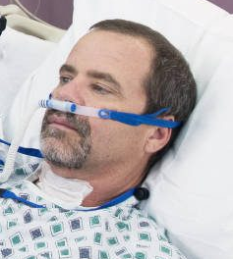
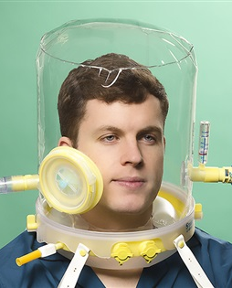
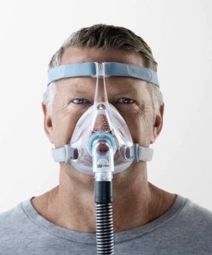
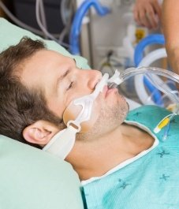
Respiratory Support
Helmet/Mask CPAP/HFNC not contraindicated but result in aerosol production-should be delivered in a negative pressure isolation room
Most patients will have type I resp failure but require higher levels of CPAP than can be delivered with HFNC
Helmet CPAP may be the best NIV option where available (lower risk of aerosol/droplet spread)
Full face mask NIV can be used
The rate of failure of NIV with COVID-19 is high
In general early IPPV in deteriorating patients is encouraged
Notes:
The use of NIV in COVID-19 is problematic as it generates aerosols. That said, many patients can be managed successfully on NIV. If NIV is being used, it should ideally be delivered in a negative pressure room.
The patients rarely have type II respiratory failure and usually have relatively normal compliance so CPAP rather than BiPAP is appropriate. While HFNC may be aerosol generating, there is no evidence of and increase in HCW infection rate. HFNC can only deliver 3-5cmH2O of PEEP and higher levels of PEEP are usually required for effect. HFNC is recommended by the surviving sepsis guidelines for COVID-19. The best NIV option is possibly 5-10CmH2O CPAP delivered via helmet to reduce droplet spread. Availability may be an issue. In general early IPPV is recommended to avoid crash intubation which increase the risk of nosocomial infection.
NIV use in COVID-19 is associated with a high failure rate (76%). Pressures of 5-20 have been used
NIV may be associated with higher ICU mortality in ARDS patients with a Pa_{O2}/Fi_{O2} lower than 150 mm Hg. (Lungsafe Study)

Slide 37
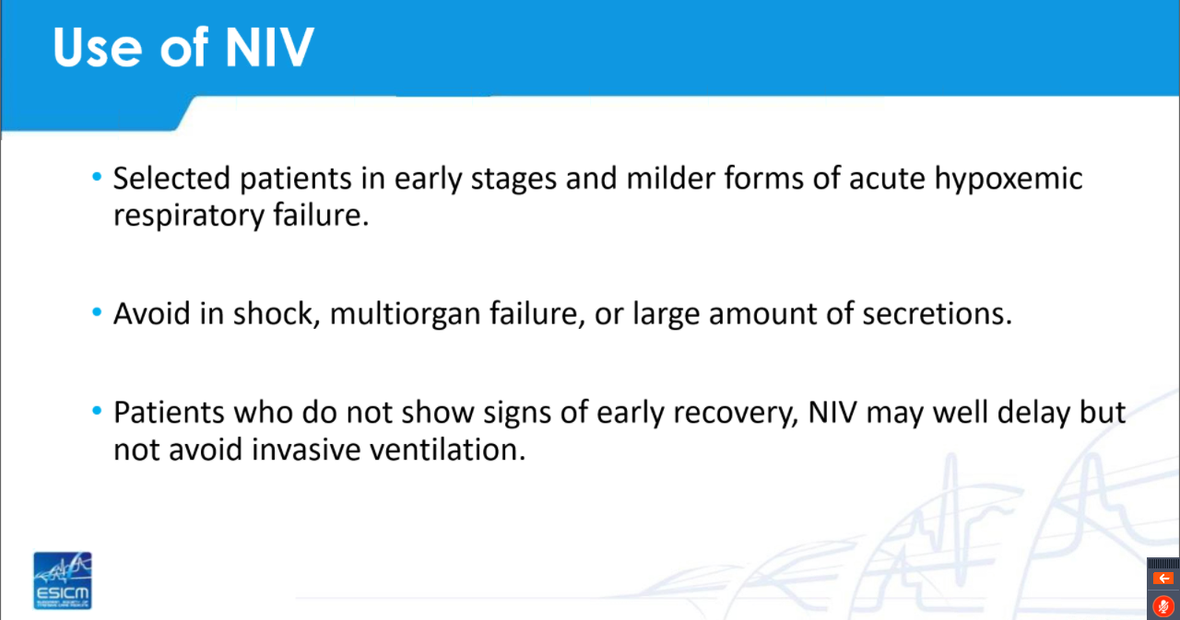
Notes:
A sensible approach to NIV in COVID-19 would be to use NIV (with previous caveats) in patients with milder failure and to intubate early if failing to improve.
Intubation should be considered in patients who have a P:F ratio of <200 after 30 mins of CPAP (5-10cmH20)

Slide 38
Mechanical ventilation
Standard protective ventilation
  Tidal Volume 4-8 mls/kg IBW
  Plateau pressure < 30 cm H2O
  Driving Pressure < 15 cm H2O
  Early NDMR if indicated
  Appropriate PEEP
  Care with Recruitment manoevrers
  Prone Ventilation if indicated
  Daily CXR may not be neccessary
https://youtu.be/qx2z26IL6g8
Notes:
Management of IPPV follows usual strategy for ARDS. Reports from many Italian centres suggest a beneficial effect from proning. There is a link to a pronation clip on the slide and a suggested escalation protocol for respiratory support at the end of this presentation. Recruitment manoeuvres may be required but usually patients recruit up over a few hours with appropriate PEEP. Pneumothorax occurs in 2% of patients with COVID-19, not necessarily related to recruitment manoevres but it is a consideration.

Slide 39
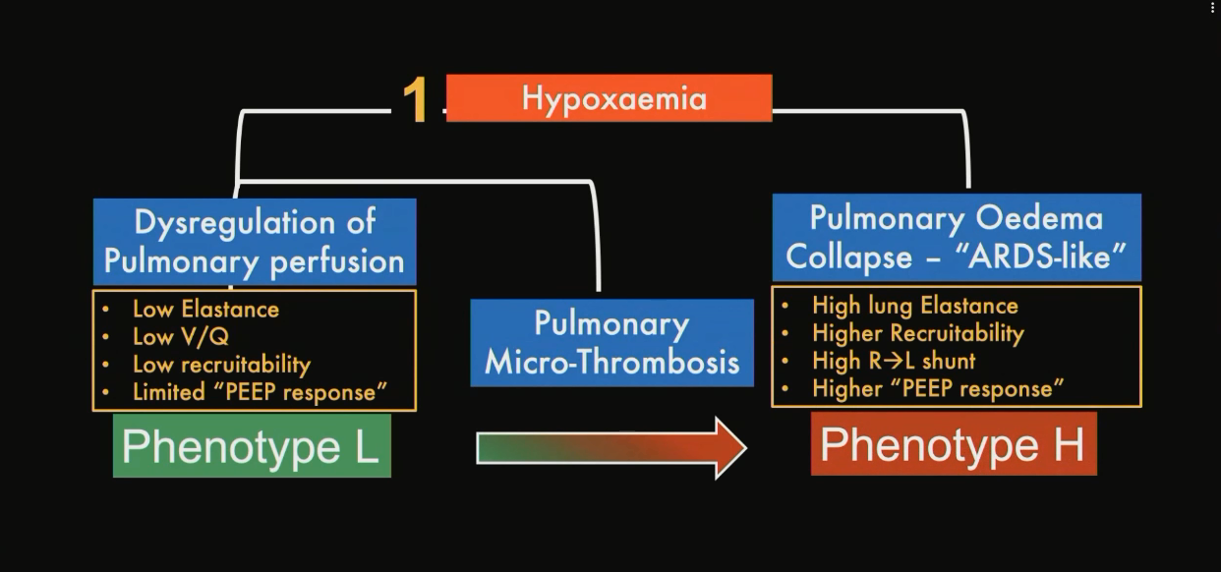
Notes:
While there has been discussion about using different ventilation strategies for different phenotypes of COVID19 ARDS, the general consensus is that standard protective lung ventilation is appropriate.

Slide 40
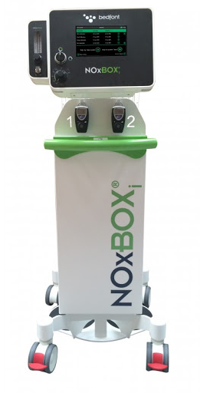
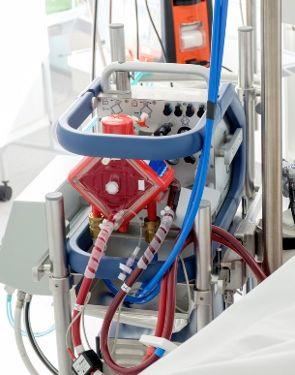
Rescue Therapy
NO
  (but minimise circuit breaks)
ECMO
  as per advice of MMH ECMO team
Notes:
Usual rescue therapies apply but HFOV has been associated with increased risk of transmission of SARS and given the lack of evidence of benefit as rescue therapy is not recommended

Slide 41
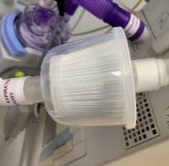
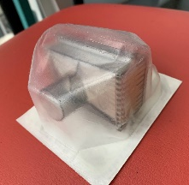
Preventing Infection while on IPPV
Closed circuit suctioning
High efficiency filter (eg BS EN 23328-1)
Minimise circuit breaks
Clamp ETT if circuit breaks necessary
Notes:
IPPV likely reduces the risk of nosocomial infection compared to NIV but circuit breaks need to be kept to a minimum.

Slide 42
Liberation from Mechanical Ventilation
COVID-19 patients typically require long periods of IPPV (1-2 weeks)
Anecdotally, failed extubation and stridor have been reported frequently in COVID patients
A conservative approach to extubation may be appropriate in COVID19 to reduce the need for re-intubation or post extubation NIV.
Standard approach to assessing readiness for extubation (Spontaneous breathing trial) should be used

Slide 43
Complications

Slide 44
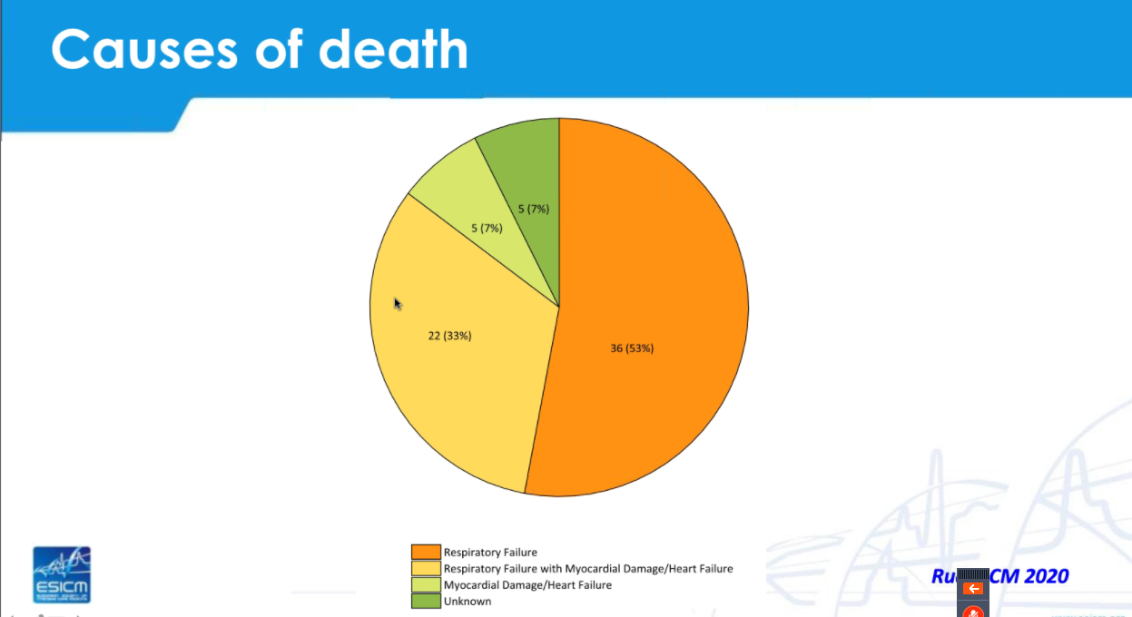
Notes:
If we look at the mode of death a significant proportion of patients develop myocardial injury. This needs to be considered when treating hemodynamic instability. Assessment of cardiac function (e.g. TTE) may be required.

Slide 45
Treatment of shock
As per surviving sepsis guidelines
Use flow indicators to guide therapy (CRT, Lactate etc.)
Early use of noradrenaline
Avoid excessive volume administration
Treat AKI as per standard ICU patient
Notes:
While treatment of shock generally follows surviving sepsis guidelines, a conservative fluid strategy needs to be followed to avoid worsening hypoxic respiratory failure with fluid overload. Early use of noradrenaline for hypotension is encouraged once markers of perfusion are reasonable.

Slide 46
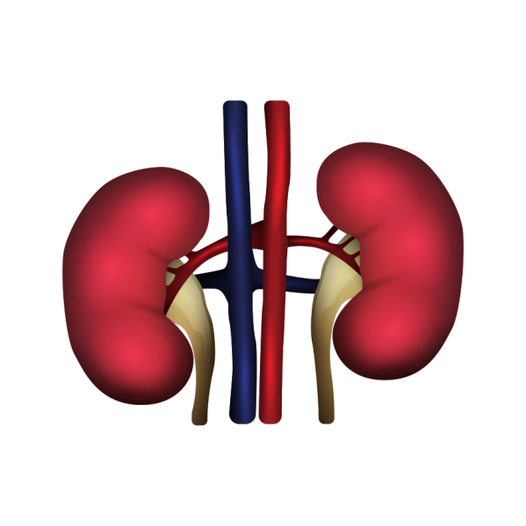
Acute Kidney Injury
About 35% of COVID19 patients will develop AKI stage 2-3 with 5% requiring RRT (4.9% in Ireland).
The need to provide renal replacement therapy (RRT) to an increasing number of critically ill patients during the COVID-19 pandemic may exceed resource capacity.

Slide 47

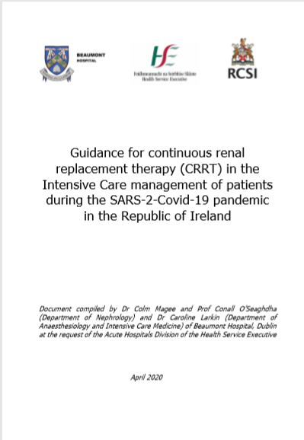
Guidance has been produced for Continuous Renal Replacement Therapy at the request of the HSE.
Due to the increased international demand for CRRT it is anticipated that there will be a shortage of CRRT consumables for the foreseeable future. • Strategies to maximise our capacity to deliver RRT in critical care units with limited resources are required. These include:
Tailored management of AKI in COVID to reduce need for RRT
CRRT delay or avoidance by maximising medical therapy
Maximising efficiency of CRRT
Use of alternate RRT modalities, including intermittent haemodialysis (IHD) and acute peritoneal dialysis (PD)
Documents available to download at XXXXXX

Slide 48
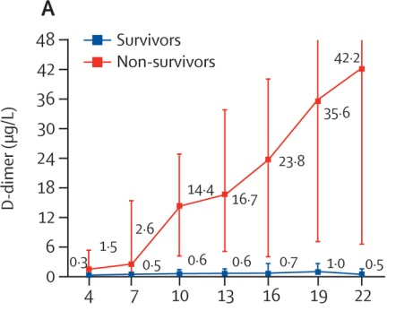
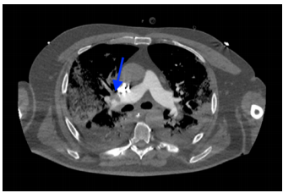
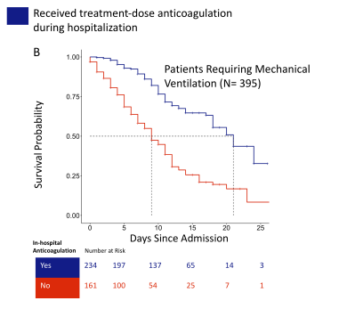
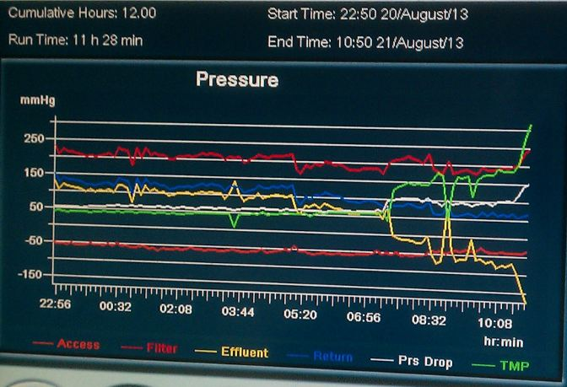
Thrombosis
Zhou Lancel 2020
Paranjpe I, JACC 2020
Notes:
Severe COVID19 is associated with a hypercoagulable state and the incidence of pulmonary embolism and CRRT circuit clotting is higher than for other patients with ARDS. One US cohort study found an improvement in survival in patients with severe disease who received treatment dose anticoagulation (Paranjpe I, JACC 2020) but there are multiple methodological issues with the study and the results of RCTs are awaited

Slide 49
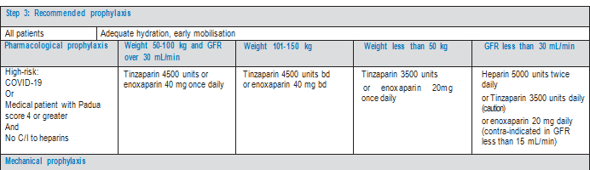
Current HSE guidance for anticoagulation in COVID19
Notes:
Current HSE guidance for anticoagulation in these patients above.

Slide 50
Outcome and Prognostication

Slide 51
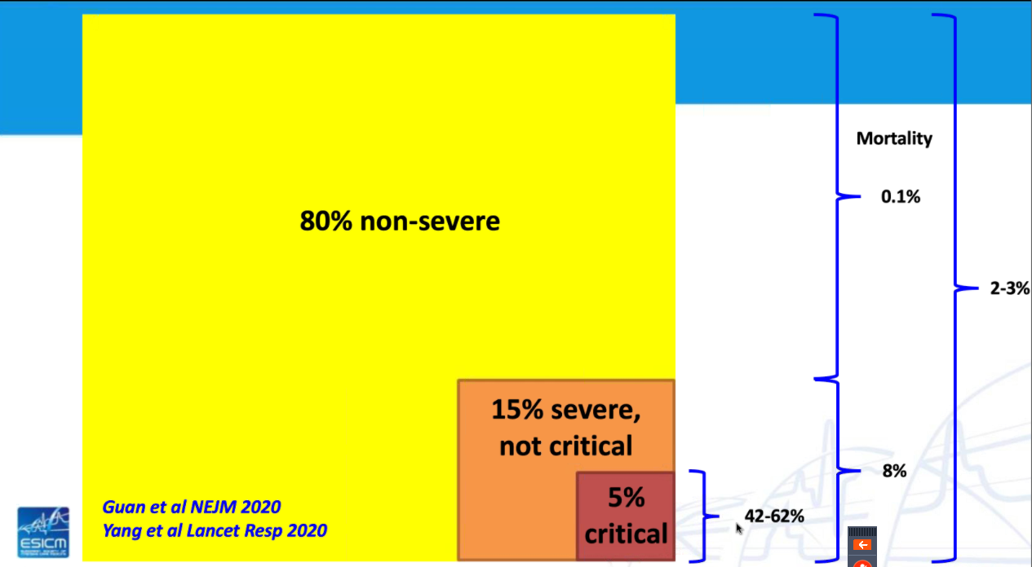

Notes:
Given that many patients with COVID-19 have mild or even asymptomtic infection, the reported mortality rate will vary depending on the criteria for testing but is probably about 0.5-1% for all infections. For documented infection the mortality rate is 3.6% but it is 8% in severe infection and up to 62% in patients requiring ICU care. For patients requiring IPPV mortality rates of 35-100% (mean 71%) have been reported in China.
In Italy a higher proportion of positive patients (12%) required ICU admission and the mortality rate for confirmed disease is 9.5%.

Slide 52
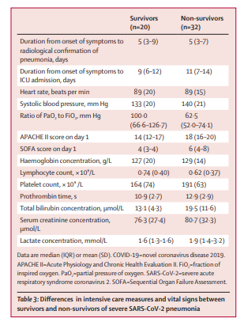
Notes:
The average P:F ratio of intubated patients in China and Italy was 100 which puts these patients into the severe ARDS category.

Slide 53

Notes:
And the mortality rate for severe ARDS is 40% which is consistent with the COVID-19 data.

Slide 54

Notes:
The mortality rate increases with age but it can be occasionally severe or fatal in young people and those without comorbidities. In general in the intensive care population, frailty predicts mortality far better than chronological age. Given the need for 1-2 weeks of mechanical ventilation in survivors, the long term functional outcome of survivors needs to be considered.
Children seem to get very mild or asymptomatic infection but may act as vectors.

Slide 55


The Criteria for assessment of the Sequential Organ Failure Assessment (SOFA)
Older age, high SOFA score, and d-dimer greater than 1 µg/mL could help clinicians to identify patients with poor prognosis at an early stage
Zhou et al Lancet 2020
Notes:
Zhou et al found older age, higher SOFA score and elevated d-dimer levels (>1ug/ml) (OR for death of 18) at admission to hospital to be associated with increased mortality.

Slide 56

Outcome for Patients admitted to ICU
Notes:
The above case series are not directly comparable but overall, ICU patients are older, present with moderate ARDS, have a high requirement for IPPV and mortality is variable but in the 20-67% range. Irish ICU mortality figures are likely to be in this range with early mortality in the first 123 patients at 5.7%.

Slide 57

Inter Hospital transfer and COVID-19
May be occasionally required
Standard inter-hospital protocols apply with additional infections prevention and control precautions (full PPE worn by all crew and appropriate ventilator tubing filters)
Notes:
Inter hospital transfer of COVID-19 patients may be required. The transferring team must use full PPE for the duration of the transfer and viral filters must be placed as indicated in the above photo

Slide 58

Notes:
And it is important to remember that the remember that much of what we do with COVID-19 patients in ICU is usual critical care with some caveats.

Slide 59
CARDIOPULMONARY RESUSCIATION & DNAR DECISION MAKING DURING COVID-19

Slide 60

This guidance is for health and social care professionals (HSCP’s) regarding advance care planning and cardiopulmonary resuscitation (CPR) decision-making including making Do Not Attempt Resuscitation (DNAR) decisions. It is provided in the context of the COVID-19 pandemic.
HSE National Quality Improvement Team, Office of the Chief Clinical Officer
https://www.hse.ie/eng/about/who/qid/other-quality-improvement-programmes/assisteddecisionmaking/hse-guidance-cpr-dnar-v1.pdf

Slide 61



In-hospital
Cardiopulmonary
Resuscitation (CPR) for Suspected / Confirmed COVID-19 cases
Download infographic at
http://hse.drsteevenslibrary.ie/ld.php?content_id=32825294

Slide 62

The National Public Health Emergency Team (NPHET) approved the guidance document “Ethical considerations relating to critical care in the context of COVID-19”. (April 3rd).
This guidance is directed at clinical staff who may be involved in making decisions regarding the prioritisation of critical care resources in the context of COVID-19.
In particular to situations where resource scarcity arises and rationing decisions have to be made .
Patients with COVID-19 and other patients requiring intensive care are treated according to the same criteria. Available resources are to be allocated fairly and in a consistent manner.
https://www.gov.ie/en/publication/13ead5-ethical-considerations-relating-to-critical-care-in-the-context-of-c
Ethical Considerations for PPE Use by Healthcare Workers in a Pandemic
Ethical Considerations Relating to Critical Care in the context of COVID-19
Notes:
The Department of Health has issued ethical guidance relating to critical care in the context of pandemic COVID19

Slide 63
Conclusions
Ongoing need for ICU care of 150-200 COVID patients
Prevent Nosocomial infection
Aim for euvolaemia
Some patients will manage on CPAP
Intubate early in deteriorating patients
Standard ARDS care
1-2 weeks on IPPV
Low threshold for therapeutic anticoagulation
ICU mortality likely 20-50%
Await RCT for effective treatments

Slide 64


ACCESS TO LATEST COVID-19 INFORMATION – HSE
The HSE have developed a repository for Interim Clinical Guidance intended for the Clinical Community
This site provides a national accessible repository of clinical guidance and latest research evidence to respond to Covid-19.
The content of the site is not meant to replace clinical judgment or specialist consultation. The guidance will be updated as the situation changes.
Please click here or copy this link into your browser
https://hse.drsteevenslibrary.ie/Covid19V2

Slide 65

Dr John Bates
Consultant Intensivist Dean, Joint Faculty of Intensive Care Medicine of Ireland
Dr Vida Hamilton
Consultant Intensivist and National Clinical Advisor and Group Lead (Acute Hospitals)
Acknowledgements

Slide 66
Useful Resources:
https://www.intensivecare.ie/wp-content/uploads/2020/02/ICS-Guidelines-COVID-19-V2-1.pdf
https://www.who.int/publications-detail/clinical-management-of-severe-acute-respiratory-infection-when-novel-coronavirus-(ncov)-infection-is-suspected
https://www.hpsc.ie/a-z/respiratory/coronavirus/novelcoronavirus/algorithms/
https://www.hpsc.ie/a-z/respiratory/coronavirus/novelcoronavirus/guidance/
https://www.nejm.org/coronavirus?cid=DM88295&bid=163494080

Slide 67
Suggested ARDS Mechanical Ventilation Protocol
For Confirmed or Suspected COVID-19
March 2020
Notes:
The following protocol is suggested as a reasonable approach to the respiratory support of patients with COVID-19 confirmed or suspected SARI. It is not a substitute for clinical judgement and clinician discretion is advised.

Slide 68
ACUTE HYPOXIC RESPIRATORY FAILURE – PF RATIO <200
Patient Suitable for Critical Care?
COVID 19 PRESENT OR SUSPECTED
ANTIBIOTICS
Aim for Euvolaemia
OXYGEN THERAPY via FACEMASK – Target PO2: 8 – 10kPa, SaO2>90
IMPROVED PFR >200
NOT IMPROVED PFR<200
Consider CPAP via HELMET (if available)– 5-10cmH2O
COVID 19 negative?
Reassess at 30 mins. IF P:F ratio <200 consider intubation
IF NOT IMPROVED AT 12 HOURS or P:F ratio < 150, or respiratory distress INTUBATE
HFNC ok
INTUBATE AND VAC-PEEP – Propofol/Opioid Sedation

Slide 69
Acute Hypoxic Respiratory Failure due to COVID19 PaO2/FiO2<200
Intubate – VAC Ventilation
TV 350ml Female (adjust)
TV 425ml Male (adjust)
Sedate to RASS -4
Limited use of RM*
PEEP = 10cmH₂O
After 2 hours reassess
PaO₂/FiO₂ >125
Bilateral Infiltrates CXR
Moderate ARDS
PaO₂/FiO₂ <125
Bilateral Infiltrates CXR
Moderate-Severe ARDS
Continue sedation RASS-4
Administer Cis-Atracurium
Sedate to RASS -2
Continue Vent Strategy
Notes:
Calculate predicted body weight (PBW):
Males = 50 + 2.3 [height (inches) - 60]
Females = 45.5 + 2.3 [height (inches) -60]
*Patients usually improve initially on appropriate PEEP. Patients may respond to careful recruitment manoeuvre (35 cm H2O for 35 secs) if required but beware hemodynamic instability in aggressively diuresed patients. Pneumothorax can occur in COVID-19.

Slide 70
Moderate to Severe ARDS PaO2/FiO2<125
AC Ventilation
Sedate to RASS -4
Cisatracurium (BIS <60)
TV<6ml/kg IBW
PEEP/Paw Adjusted to
Keep PaO₂ >8kPa
Consider APRV
Every 4 hours reassess
PaO₂/FiO₂ <100
PaO₂/FiO₂ >100 <200
Moderate ARDS
PaO₂/FiO₂ >200
Turn the patient
PRONE for 16 hours
Reassess every 2 h
Continue cisatracurium
For 48 hours
Turn off NDMR
Vent Liberation Protocol
No Improvement
Discontinue NDMR after
48 hours, Reassess PFR
Consider iNO/ECMO*
Notes:
Calculate predicted body weight (PBW):
Males = 50 + 2.3 [height (inches) - 60]
Females = 45.5 + 2.3 [height (inches) -60]

Slide 71
At 24h PF Ratio > 200
No
PEEP <10 and Lung Compliance >40ml/cmH₂0
Continue Mechanical Ventilation
Yes
Wean Sedation
Wean to PSV
COVID-19 Negative
COVID-19 Positive
Liberate to HFNC / CPAP
Liberate Only When PFR >250
Liberate to Oxygen by Facemask
Max flow 6L
Ventilator Liberation Protocol
Notes:
Airway pressures should be weaned slowly. Delayed deterioration is common after initial improvement on IPPV.

Slide 72

ARDSnet PEEP Protocol

Slide 73

MAXIMAL ALLOWABLE TIDAL VOLUMES BASED ON PREDICTED BODY WEIGHT
(PBW)
FEMALE
HEIGHT feet | HEIGHT cm | TV 6ml/kg
5' 0 | 152.4 | 275
5' 1 | 155 | 290
5' 2 | 158 | 300
5' 3 | 160 | 315
5' 4 | 163 | 330
5' 5 | 165 | 340
5' 6 | 168 | 360
5' 7 | 170 | 370
5' 8 | 173 | 385
5' 9 | 175 | 400
5' 10 | 178 | 410
5' 11 | 181 | 425
6' 0 | 183 | 440
6' 1 | 186 | 450
6' 2 | 188 | 465
6' 3 | 191 | 480
6' 4 | 193 | 495
350ml

Slide 74

MAXIMAL ALLOWABLE TIDAL VOLUMES BASED ON PREDICTED BODY WEIGHT
(PBW)
MALE
HEIGHT feet | HEIGHT cm | TV 6ml/kg
5' 0 | 152.4 | 300
5' 1 | 155 | 315
5' 2 | 158 | 330
5' 3 | 160 | 340
5' 4 | 163 | 355
5' 5 | 165 | 370
5' 6 | 168 | 385
5' 7 | 170 | 400
5' 8 | 173 | 410
5' 9 | 175 | 425
5' 10 | 178 | 440
5' 11 | 181 | 450
6' 0 | 183 | 465
6' 1 | 186 | 480
6' 2 | 188 | 495
6' 3 | 191 | 505
6' 4 | 193 | 520
425ml
Notes:
Formula:
Females: PBW (kg) = 45.5 + 2.3 (height (in) – 60)
Males: PBW (kg) = 50 + 2.3 (height (in) – 60)

